Slide 1
TRIBAL HEALTH CARE AND CHALLENGES IN INDIA
Dr. D. Ramkishan. M.S.Ortho
Superintendent
Government General Hospital
Mahabubnagar
Hony. President-Chenchu Lokam

Slide 2
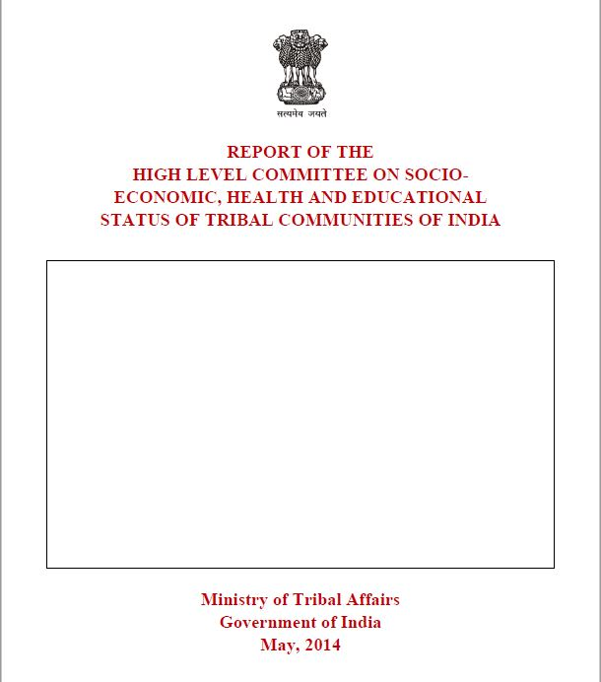
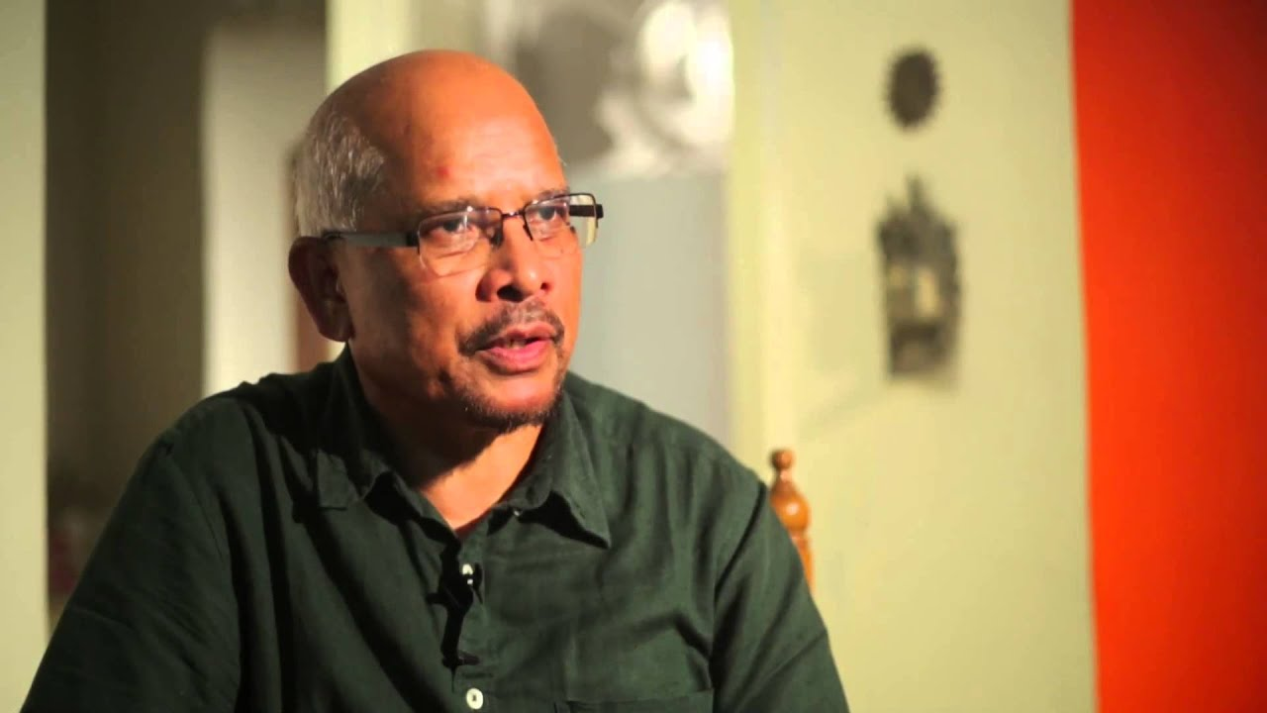

Slide 3
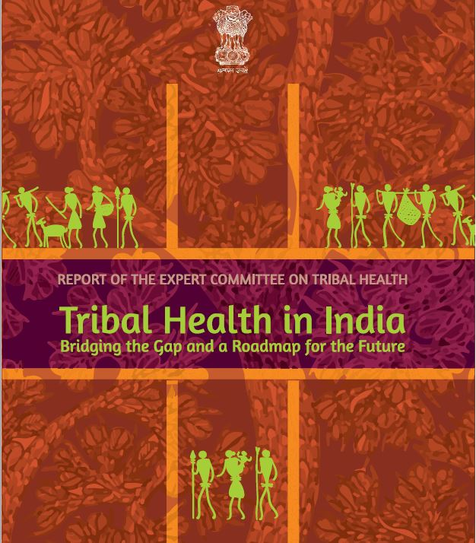
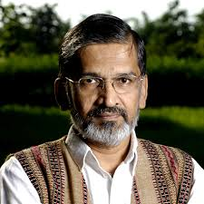

Slide 4
INTRODUCTION
Over 104 million tribal people live in India. Spread across 705 tribes, they account for 8.6% of the country's population. Cognizant of the distinct socio-culture structures and way of life in these communities , the Government of India has laid down the landmark policy expressions .
ST status-The Constitution of India – 1951.
The Panchasheel Principles.
The PESA Act- for the protection and development of tribal communities.

Slide 5
SPECIAL GOVERNANCE MECHANISMS FOR
TRIBAL DEVELOPMENT
The Constitution of India created two distinct administrative arrangements. These are the Fifth and sixth schedules that provided protection to the tribal population through laws for scheduled Areas.
The provisions of the Fifth Schedule have seen further legal and administrative reinforcement in the form of Provisions of Panchayats (Extension to Scheduled Areas) Act,1996, which empowers Gram Sabhas.
In 1999 a separate Ministry of Tribal Affairs was created to ensure the socio-economic development of scheduled Tribes in an integrated, planned and coordinated manner.
The Scheduled Tribes and Other Traditional Forest Dwellers (Recognition of Forest Rights) Act 2006 was introduced to redress the “historical injustice’ committed against forest dwellers and restore their right to land and forest produce.

Slide 6
SAFEGUARDS – COMMITTEES/ COMMISSIONS
1935- Backward Classes.
1947- Elwin Committee.
1960 – UN Dhebar Commission – land allotment in tribal areas.
1965 – Lokur Committee - scheduling of groups in ST.
1966 – The Shilu AO Committee - tribal development and welfare.
1970 – TSP Approch.
1990 – Bhuria Committee – PESA Act, 1996.
2002-2004 – Bhuria Commission.
Bandopadhyay Committee – Development and Governance in extremities areas.
Mungekar Committee on school health.
Professor Xaxa Committee 2014
Dr. Abhay Bhang committee 2018 - on Tribal Health.

Slide 7
SCHEDULED TRIBES POPULATION DISTRIBUTION IN INDIA
Where are they located?
The 705 scheduled tribes in the country can be divided into four major categories namely,
1.TRibal people living in schedule V areas and in tribal dominated blocks and districts.
2. Tribal population in North-East India
3.Particularly vulnerable tribal groups , PVTG
4.Tribal people living outside scheduled areas.
Numerically ,Madhya Pradesh has the largest ST population (15 million),followed by Maharashtra (10 million ), Odisha (9 million) , and Rajasthan (9 million).In fact, more than two thirds of the ST population lives in the 7 states of MP, Chhattisgarh, Jharkhand , Odisha , Maharashtra , Gujarat and Rajastan. [ Continue…

Slide 8
TRIBAL POPULATION
The concentration of tribal population is highest amongst the North Eastern states 6th Schedule.
Almost 90% of the tribal population of the country lives in rural areas. There are 90 districts or 809 blocks with more than 50% tribal population and they account for nearly 45% of the ST population in the country.
In other words ,almost 55% of the tribal population lives outside these 809 tribal majority blocks.

Slide 9
SOCIAL DETERMINANTS OF HEALTH
Literacy, income, water, sanitation, fuel, food security and dietary diversity, gender sensitivity, transport and connectivity – play very important role in determining the health outcomes.

Slide 10
The Poor economic status :
40.6% ST population lived below poverty line as against 20.5% of the non-tribal population in the country.
Access to amenities:
Only 10.7% of the tribal population has access to tap water as against 28.5 % of the non-ST population. Three out of every four tribal (3/4) people (74.7%) continue to defecate in the open. Use of clean cooking fuels among non-ST's is more than three times compared to ST's.
Education:
About 41percent of the ST population in India is illiterate as compared to 31 percent of the non-ST population While 35% tribal people had attained primary education, less than 2% had received higher education. Nationally, only 6.7% of ST population above 18 years of age have completed 12 years of education.

Slide 11
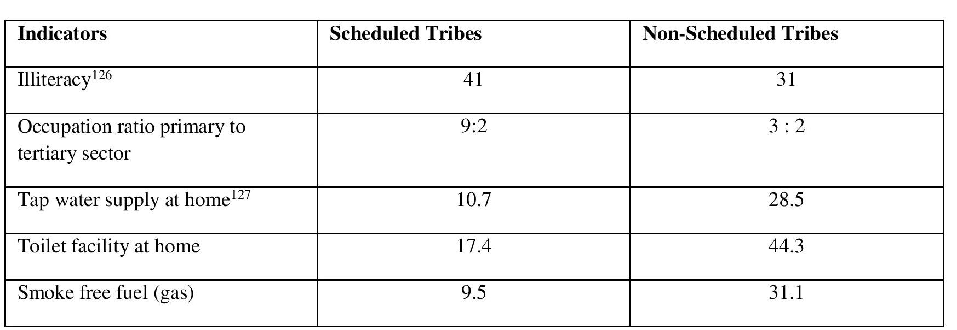
The Social determinants of health are heavily pitted against the health of the Scheduled Tribe population. For example, the following differences are noted among Scheduled Tribes in comparison to the general population.

Slide 12
THE MORTALITY INDICATORS
Scheduled Tribe population have certainly improved during the past decades. However, these are significantly worse than of the general population. A comparison on a few important child mortality indicators is as follows:
S.No | Indicators | ST | Other | % diff.
1 | Infant Mortality Rate | 62 | 49 | 27%
2 | Under Five Year Child Mortality Rate | 96 | 59 | 39%

Slide 13
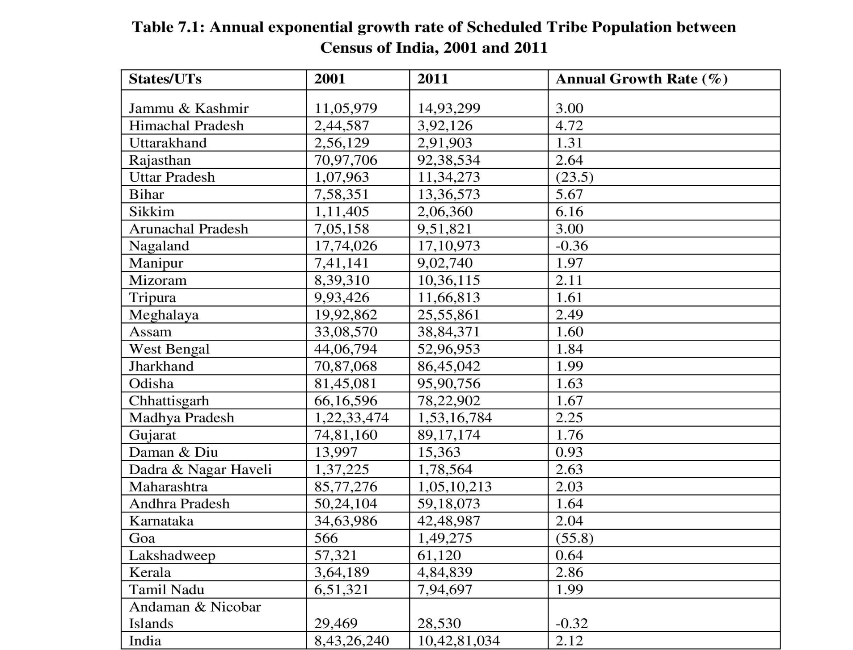

Slide 14
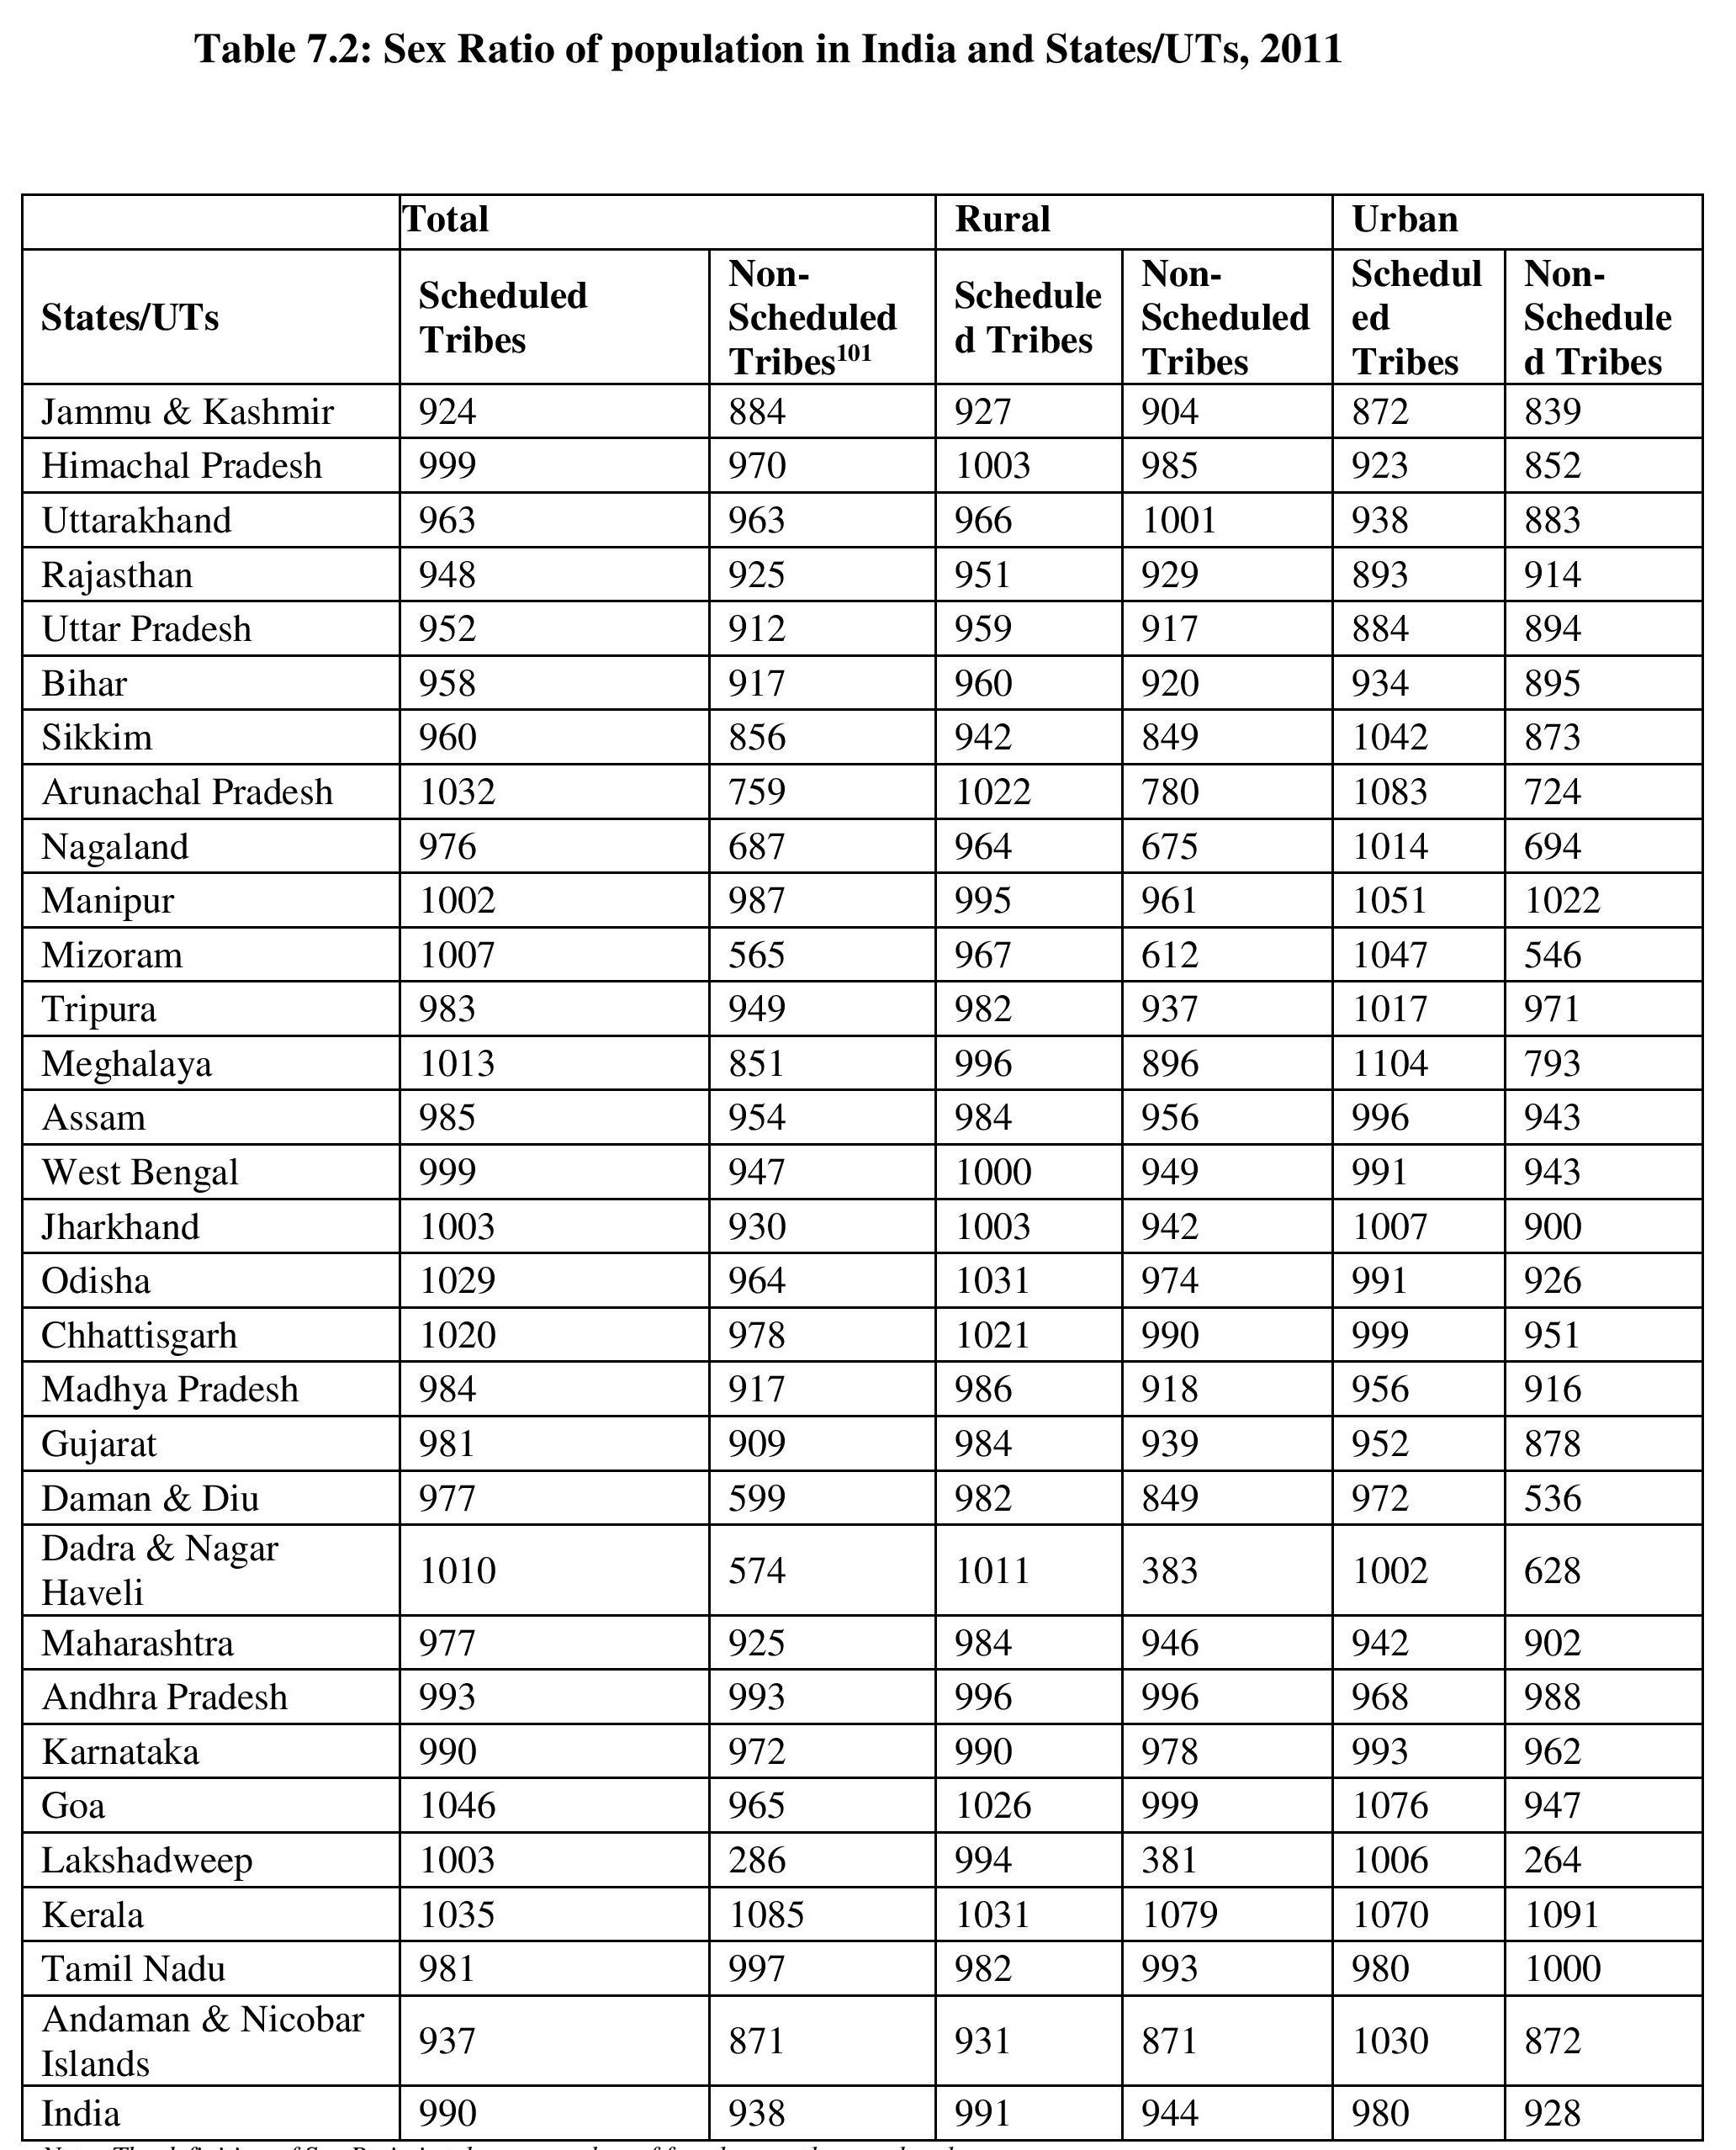

Slide 15
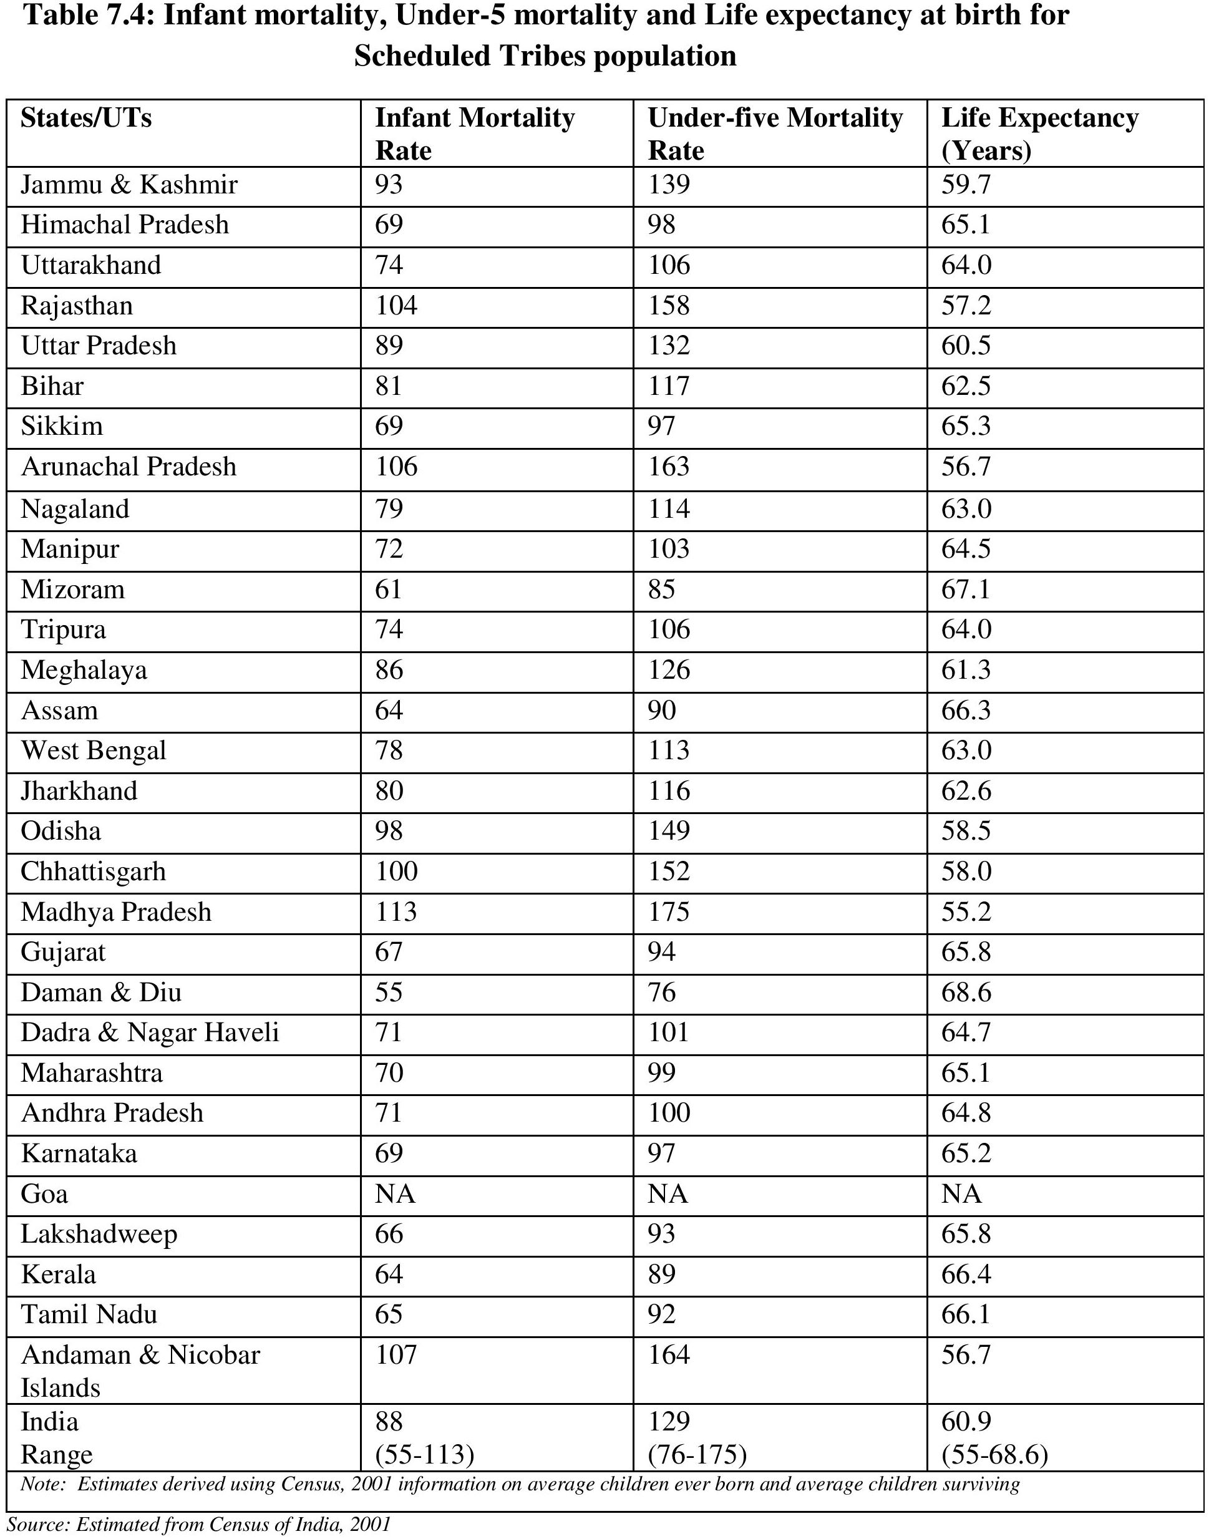

Slide 16
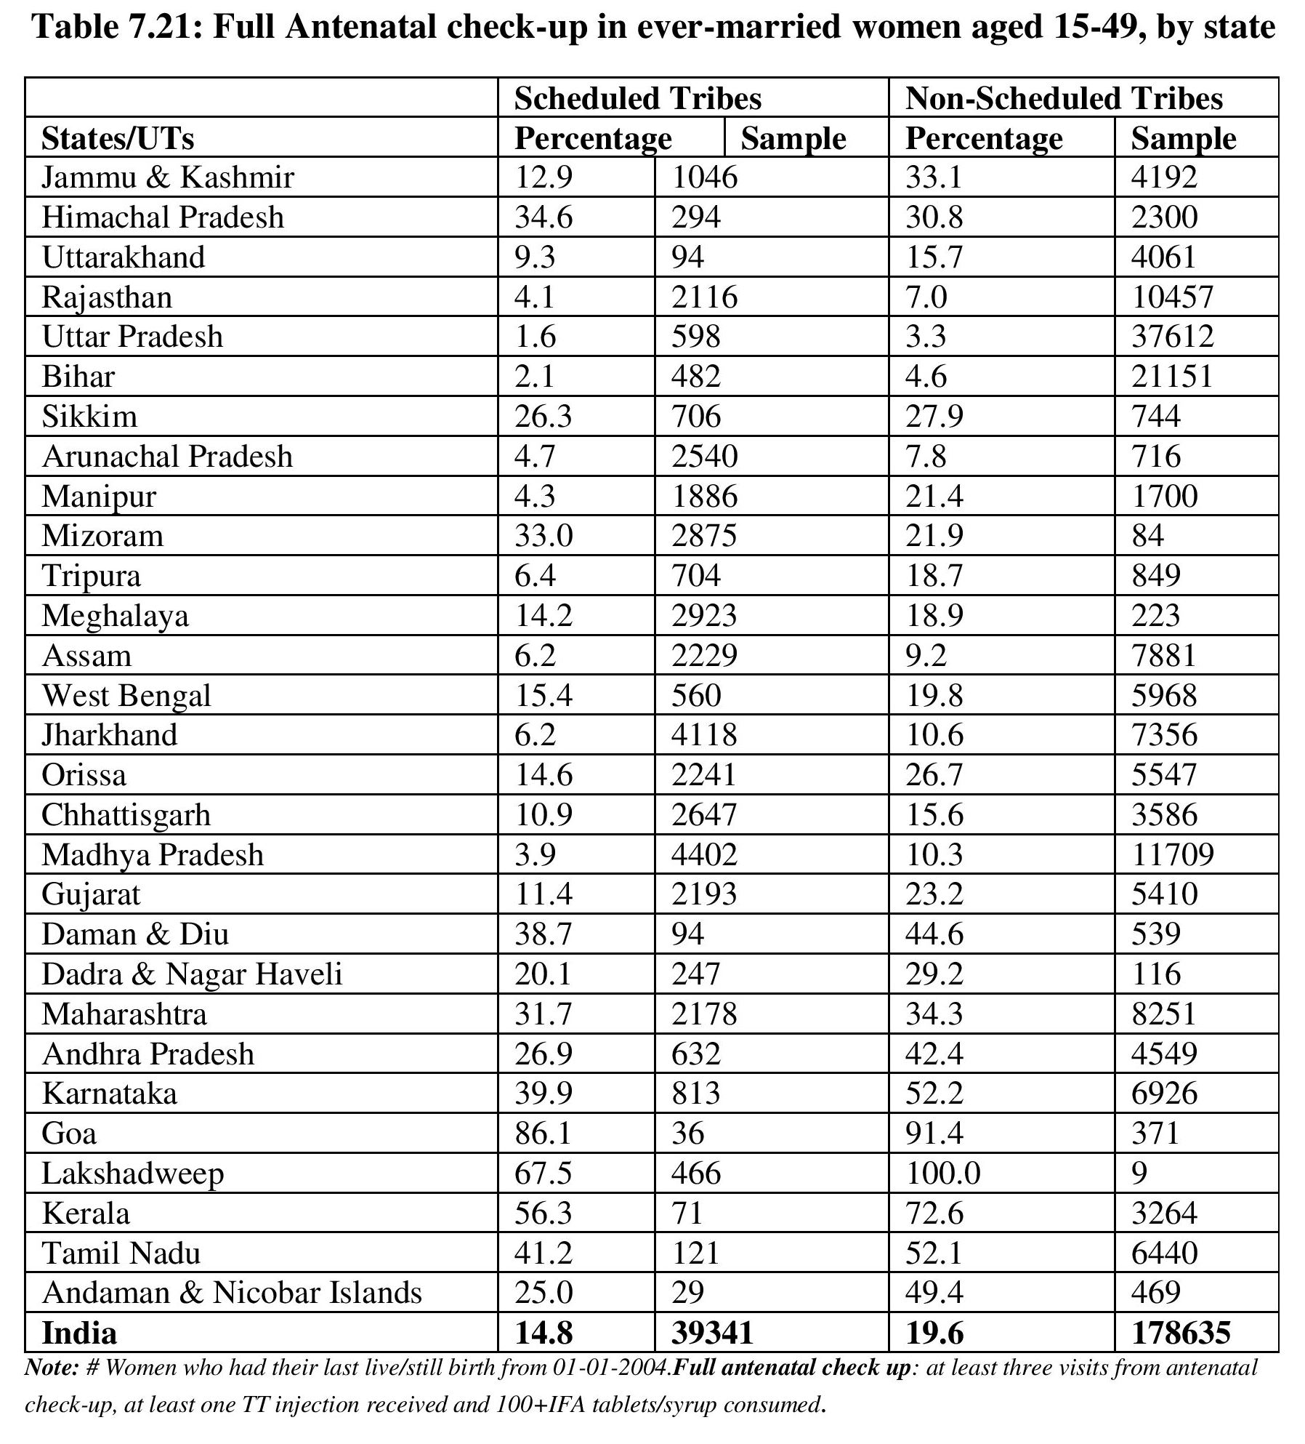

Slide 17
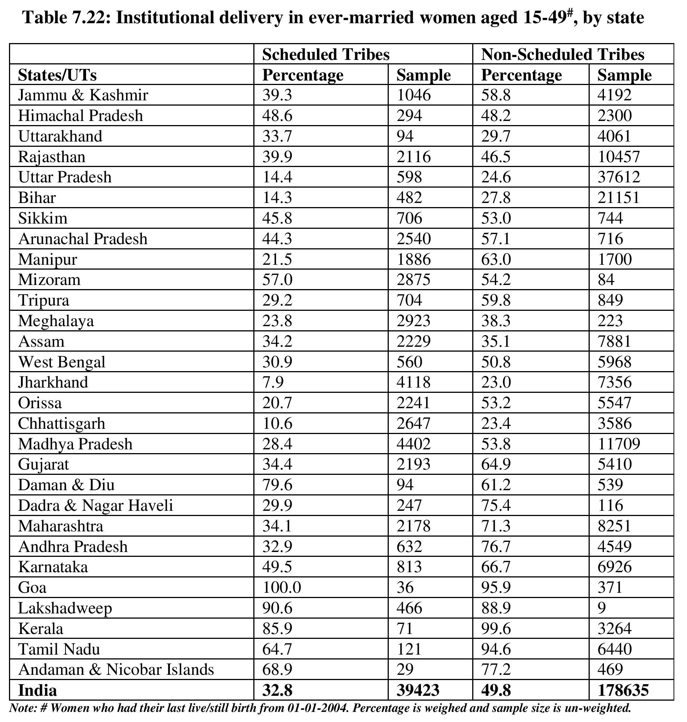

Slide 18
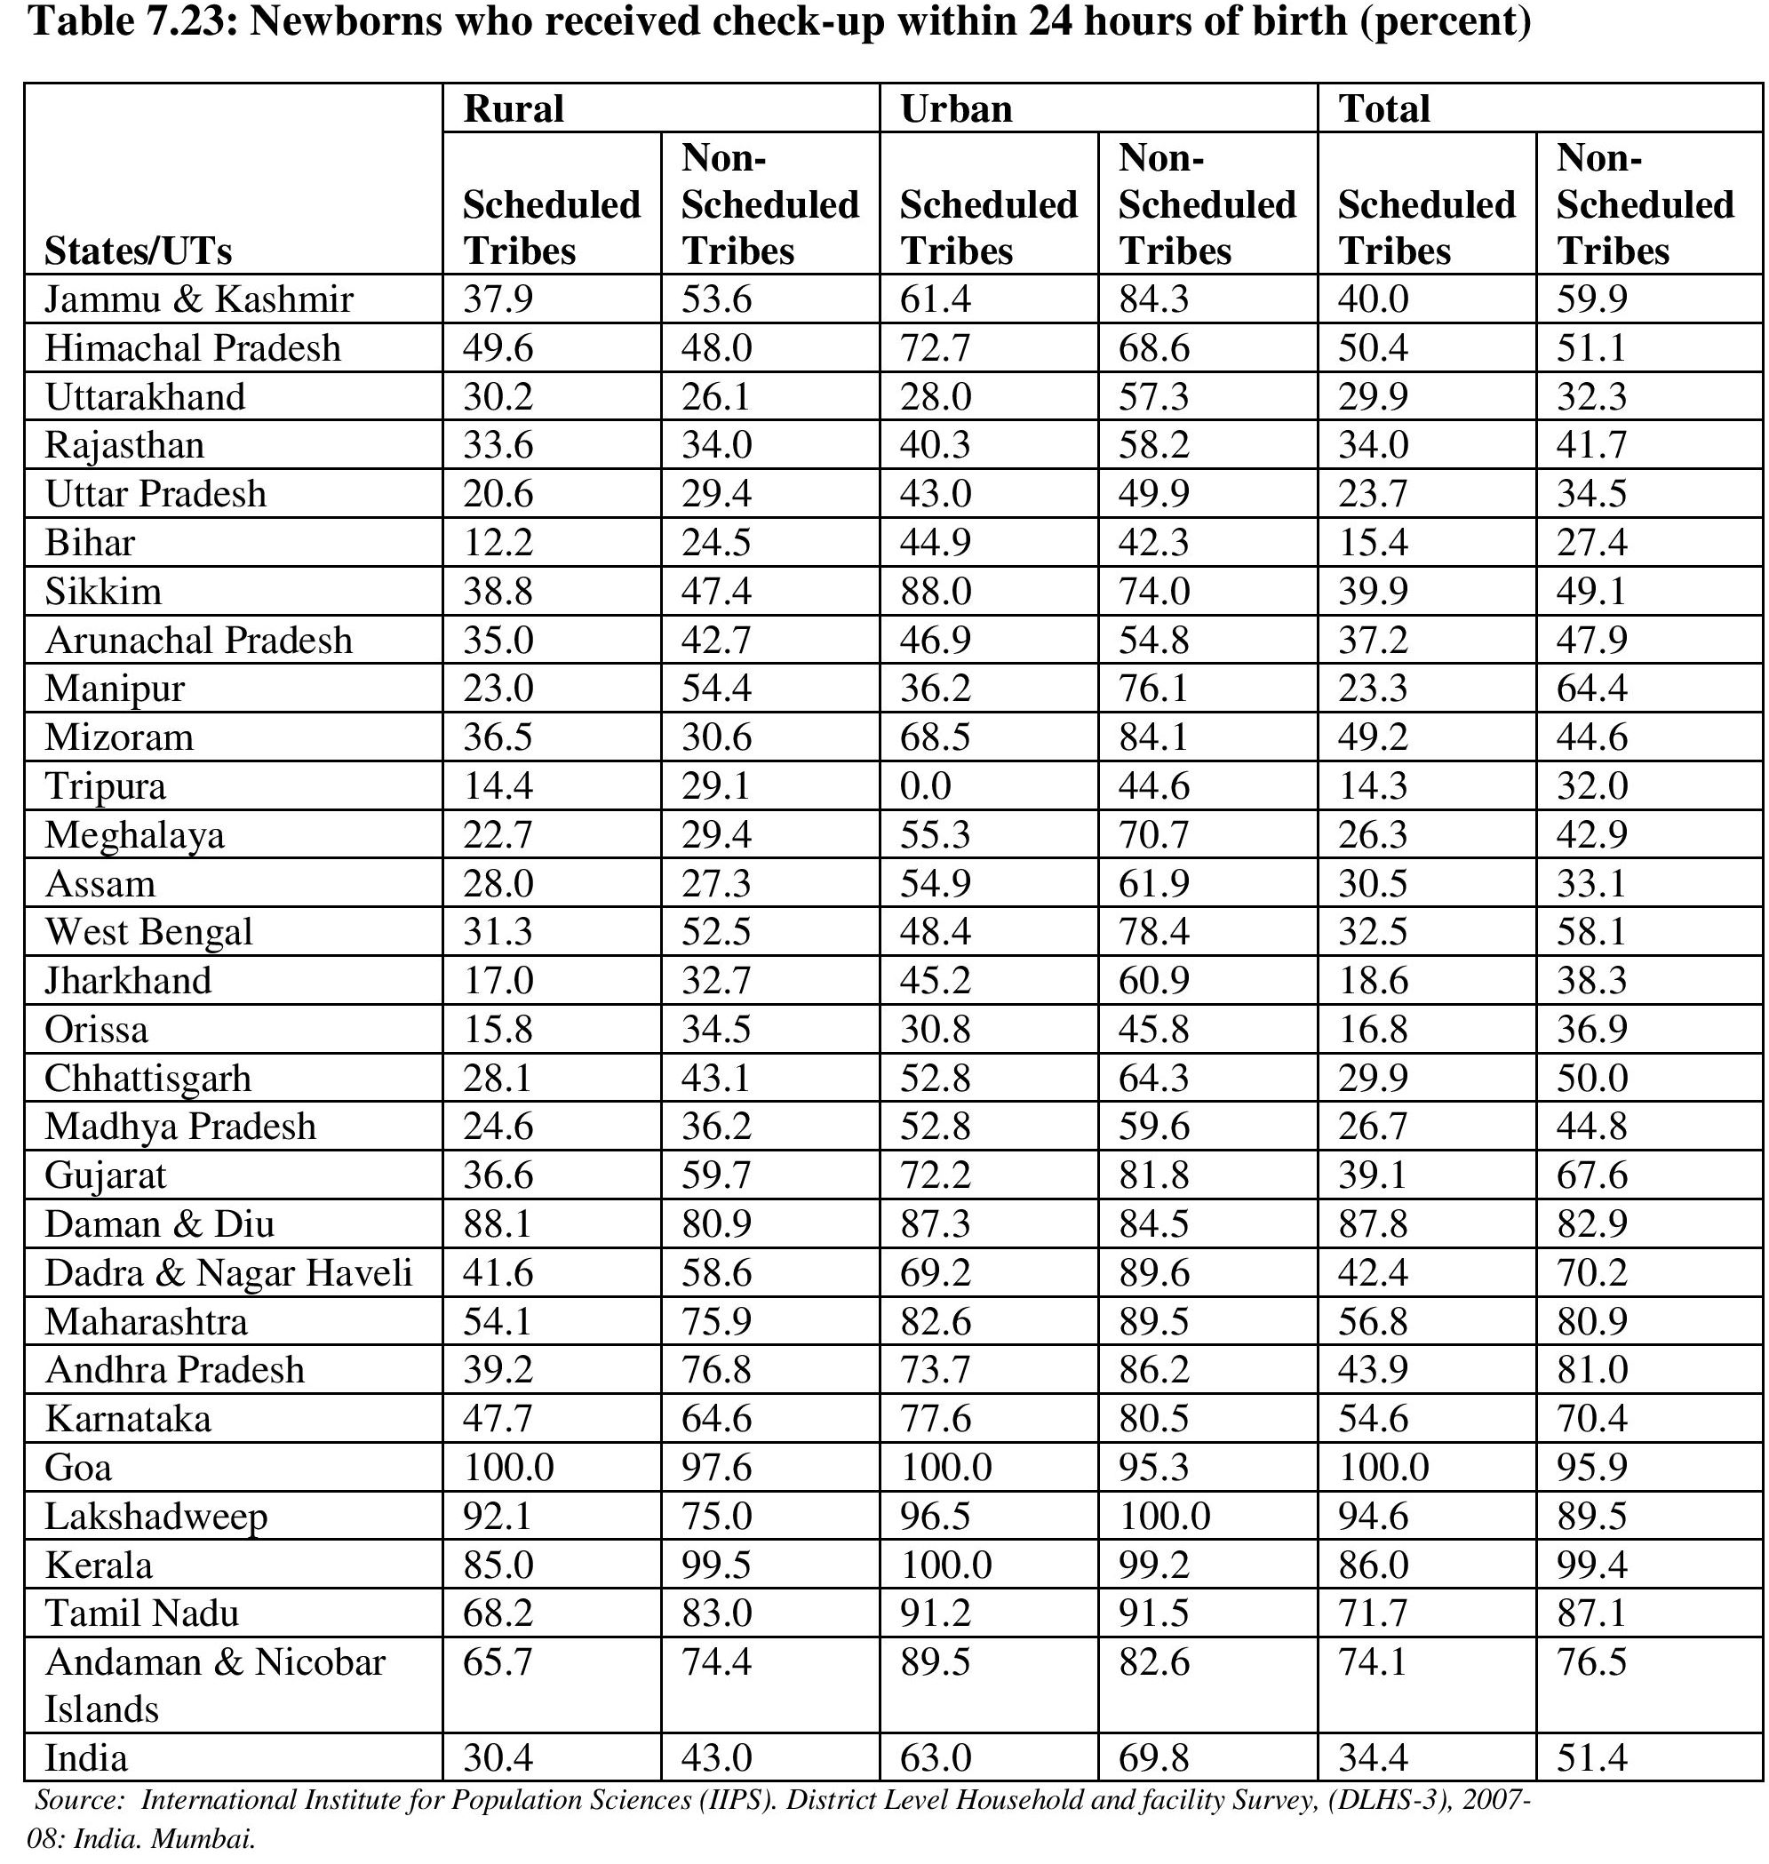

Slide 19
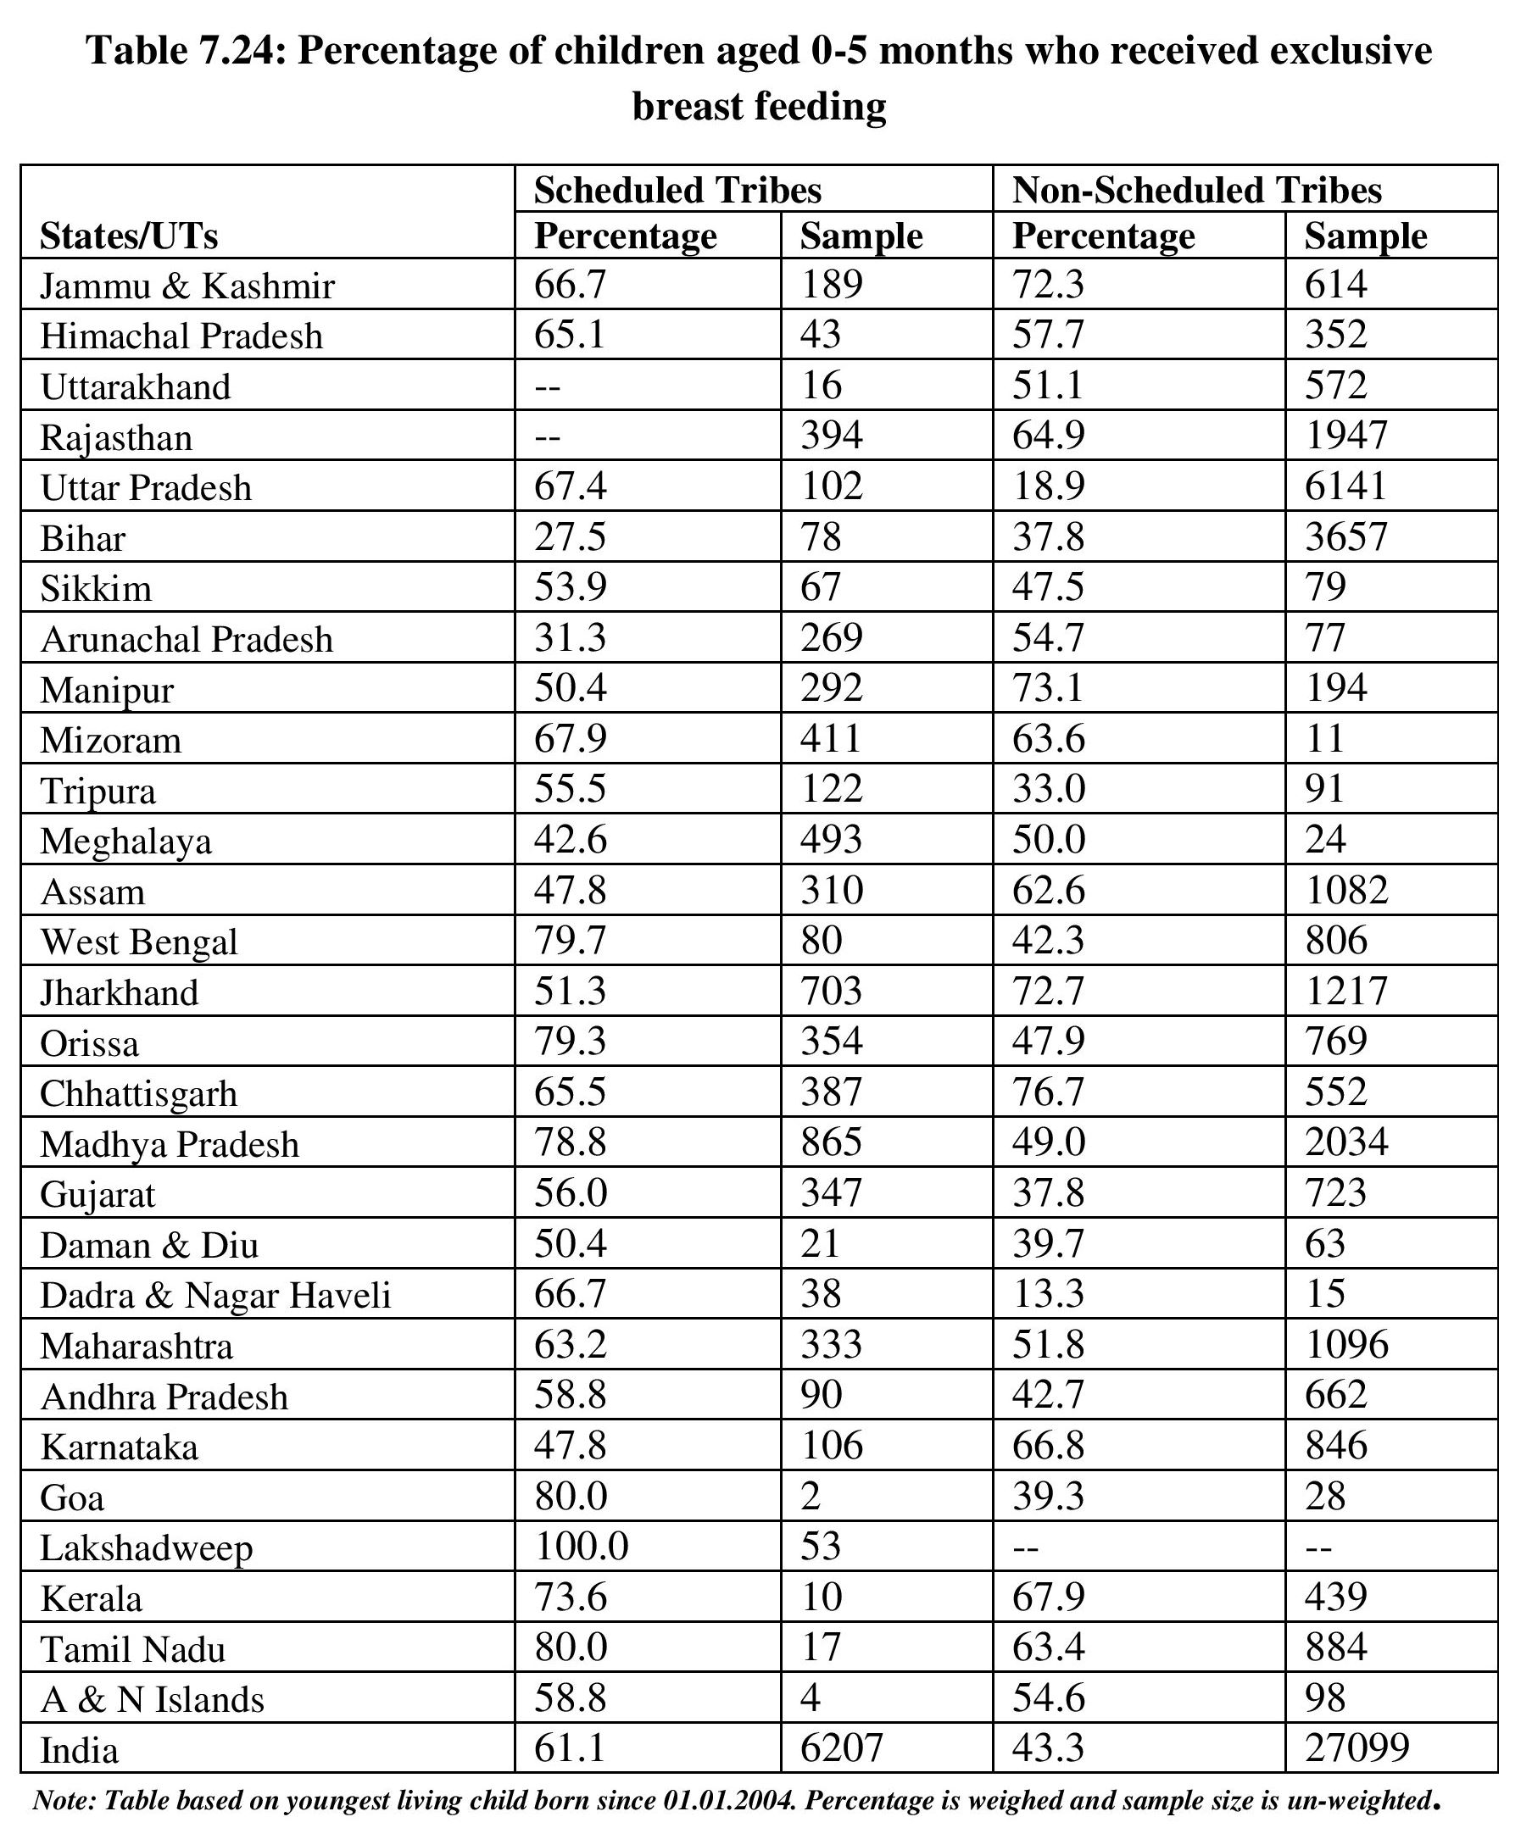

Slide 20
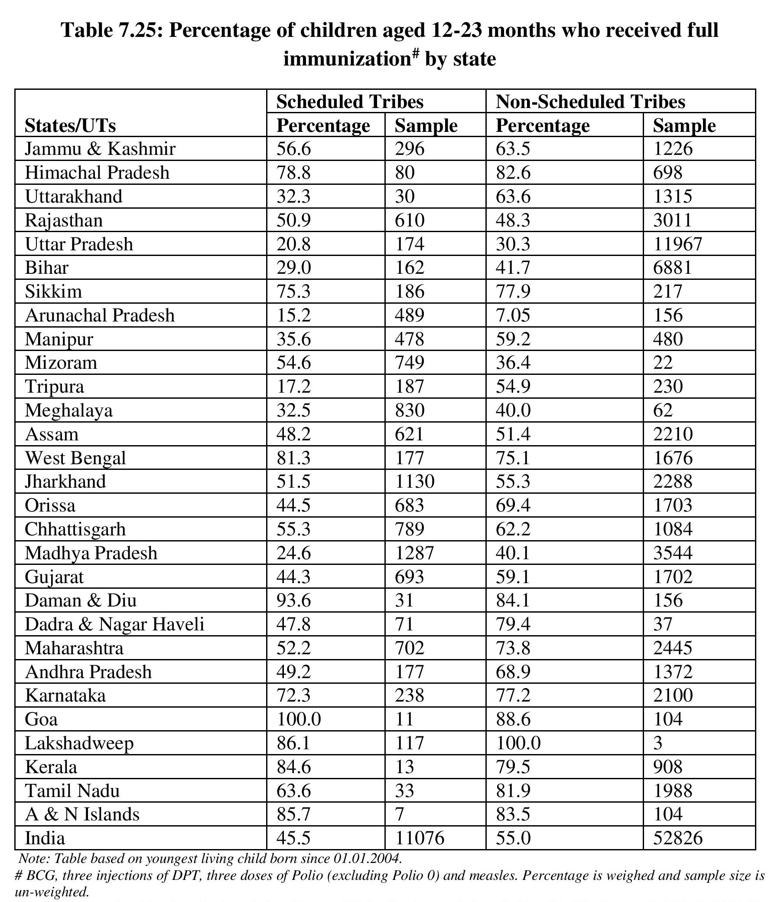

Slide 21
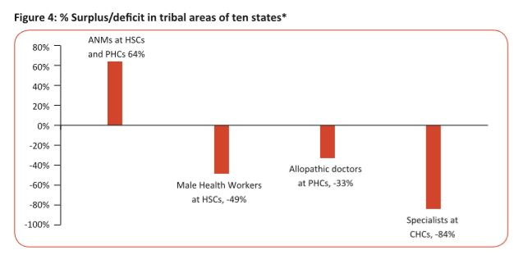

Slide 27
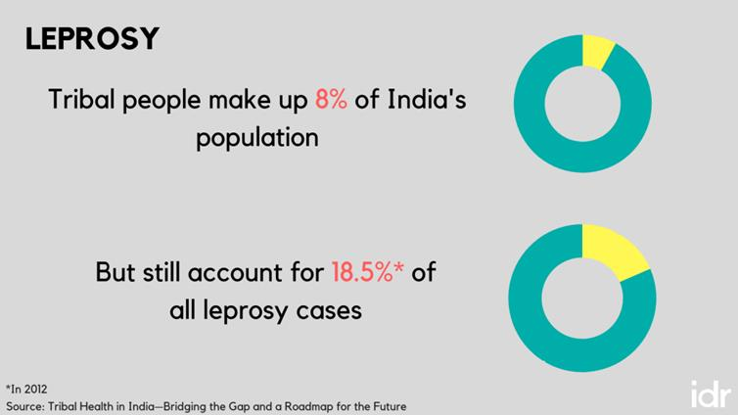

Slide 29
An annual budget equal to 2.5% GDP per capita basis must be allocated and spent on tribal healthcare it comes to approximately INR 2500 for tribal in 2015-16New entities a tribal health council and directorate for tribal health must be established at both state and Union levels to focus solely on tribal health including generating data reviewing finance and monitoring programs Service delivery needs to be restructured so that the government focus 70% of its resources for tribal health on primary care and makes the basket healthcare services larger all of the above must be matched with adequate human resources and infrastructure.

Slide 30
The nutritional status of Scheduled Tribe children as well as of adults reveals a sad picture.
53 percent boys and 50 percent girls in preschool age were underweight, and 57 percent boys and 52 percent girls were stunted in height.
49 percent of Scheduled Tribe women had a body mass index less than 18.5 indicating chronic energy deficiency.
40.2 percent of Scheduled Tribe men had a body mass index of less than 18.5 including chronic energy deficiency.
Dietary intake of tribal households showed large deficiencies in protein, energy, fats, iron, calcium, vitamin A and riboflavin.

Slide 31
TREATMENT SEEKING BEHAVIOR
More than three-fourths of Scheduled Tribe population seeks treatment from Government funded health facilities

Slide 32
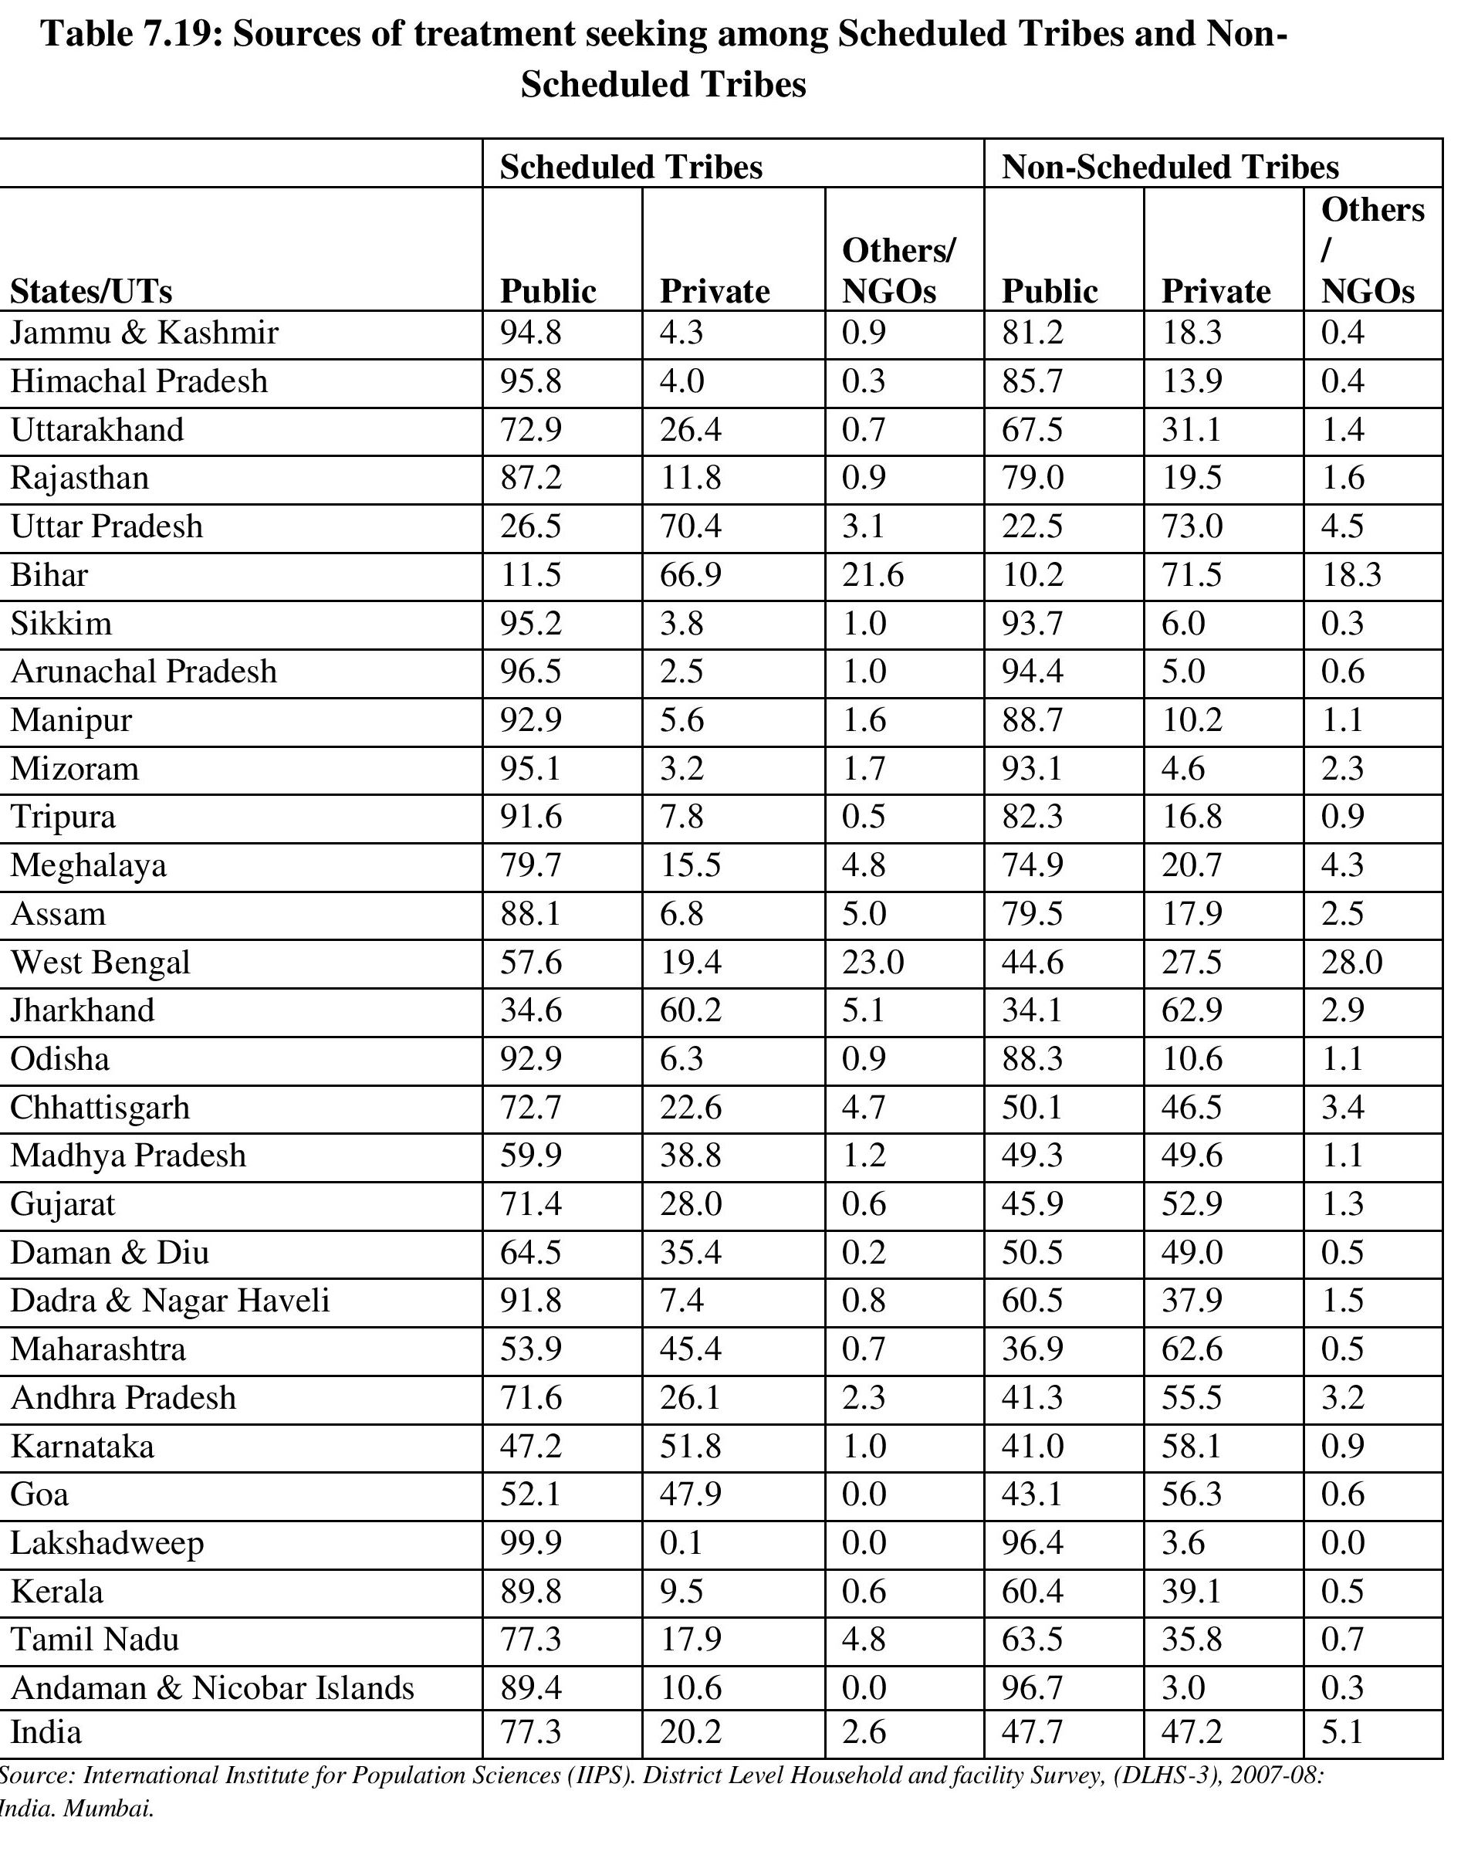

Slide 33
CHALLENGES OF TRIBAL HEALTH
Communicable diseases, maternal and child heath problems and malnutrition continue to prevail;
Non-communicable diseases including mental stress and addiction are rapidly increasing.
Injuries due to accidents, snake and animal bites and violence in conflicts situation;
Difficult natural conditions arising due to geographic terrain, distance and harsh environments;
Worse social – economic determinates, especially in education, income, housing, connectivity, water and sanitation.
Poor quality and inappropriate health care service with low access and coverage, low outputs and outcomes;
[ continues……

Slide 34
CHALLENGES OF TRIBAL HEALTH
Severe constrains in health human resource at all levels; the professionals human resource at all level; the professionals from outside are unwilling to serve in tribal areas, and the local potential human resource is not trained and utilized by the health system.
The legitimate and needed financial share for tribal health is not allocated or used in most of the states. There is lack of transparent accounting of the actual expenditure on tribal health.
Lack of data, monitoring and evaluation that masks all the above – mentioned problems;
Political disempowerment of tribal people – from the individual to the national level - that exacerbates these problems. There is little inclusion of tribal people in the planning, priority setting and in execution.

Slide 35
PUBLIC HEALTH CARE TO SCHEDULED TRIBE POPULATION IS ONE OF THE WEAKEST LINKS
It is often inappropriate for the needs in the Scheduled Areas, being a rubber stamp version of the national model primarily designed for the non-tribal areas. It does not take into account the different belief system, different disease burden and health care needs as well as the difficulties in delivering health care in a geographically scattered, culturally different population surrounded by forests and other natural forces. It is surprising that no serious thought was earlier given to design a public health care plan for Scheduled Areas

Slide 36
PUBLIC HEALTH CARE TO SCHEDULED TRIBE POPULATION IS ONE OF THE WEAKEST LINKS
Though buildings are built and health care institutions created in the form of health sub-centers, PHCs and CHCs, they often remain dysfunctional resulting in poor delivery of health care. This is further compounded by inadequate monitoring, poor quality of reporting, and accountability.

Slide 37
PUBLIC HEALTH CARE TO SCHEDULED TRIBE POPULATION IS ONE OF THE WEAKEST LINKS
The other major difficulty in delivering public health care to tribal population is the lack of health care human resource that is willing, trained and equipped to work in Scheduled Areas. There is a shortage, – vacancy, absenteeism or half-heartedness of doctors, nurses, technicians and managers in public health care system in Scheduled Areas

Slide 38
PUBLIC HEALTH CARE TO SCHEDULED TRIBE POPULATION IS ONE OF THE WEAKEST LINKS
Factors such as unfriendly behavior of the staff, language barrier, large distances, poor transport, low literacy and low health care seeking, lead to lower utilization of the existing health care institutions in Scheduled Areas.

Slide 39
PUBLIC HEALTH CARE TO SCHEDULED TRIBE POPULATION IS ONE OF THE WEAKEST LINKS
Access to hospital care for all ailments remains very low in tribal areas.

Slide 40
A reason for the inappropriately designed and poorly managed health care in Scheduled Areas is the near complete absence of participation of Scheduled Tribes people or their representatives in shaping policies, making plans or implementing services in the health sector.

Slide 41
No mechanisms in place for PESA gives Gram Sabhas, such participation or oversight at the village level. Similar situation is observed at the ITDP, district and the state levels. At the Central level, the Ministry of Health and Family Welfare has no separate body to shape policies or monitor programs in Scheduled Areas.

Slide 42
This is in complete disregard to the promise of the Constitution and the Panchsheel guidelines.

Slide 43
There is a near complete absence of basic data required to make situational diagnosis of health and health care in Scheduled Areas. The Sample Registration System, the NFHS, DLHS, AHS, NSSO – none are designed to give reliable, robust, timely and segregated estimates of health outcomes in Scheduled Tribes populations. Such data are completely subsumed in the data for the whole population making any assessment of the health of Scheduled Tribes populations very difficult if not impossible. In the absence of such quantitative estimates, the evidence-based insights and professionally sound efforts for correction have been missing.

Slide 44
Tribal people as a population segment are not politically very vocal. However, they have different geographical, social, economic and cultural environments, different kind of health cultures and health care needs.

Slide 45
WHY TRIBES SHOULD SUFFER ?
While the tribal communities continue to suffer from the huge burden of malnutrition, communicable diseases, maternal and child health problems, there is evidence of early epidemiology transition among the tribal population. This is associated with a high prevalence of hypertension(24%)
Rapid exposure to media and modern lifestyle without proper health education has accentuated these problems
The tribal health report reveals that almost seven decades after independence and despite many constitutional provision safeguard their interest the tribal population continue to suffer disproportionately from health problems compounded by problem of healthcare access and quality.
Yet Public health system including infrastructure human resources and governance in the tribal areas remain inadequate

Slide 46
WHY TRIBES SHOULD SUFFER ?
In more than half of the states with sizeable tribal population the healthcare infrastructure was 27 to 40 percent deficient in number compared to the NRHM population norms.
The shortfall of male MPWs (49%), PHC doctors(33%), and speialist at CHCs (84%) in tribal arrears is deplorable.
Our current health care delivery system is is incompatible with tribal culture and belief system, leading to low rate acceptance.

Slide 47
Thank you

