Slide 1
POST –LOCKDOWN: -WHAT MUST GOVERNMENTS DO? ….and what they must NOT do !
T. Sundararaman
Popular Science Lecture Series,
Tamil Nadu Science Forum,
April 25th, 2020

Slide 2
Identify early- Identify spread Data driven policy decisions need data-
Whatever Happened to IDSP (Integrated disease surveillance program): and what is CCC ( Covid 19 collection centers) and SSS ( special surveillance system): The principles of surveillance systems:
1. Monitoring Suspect, Presumptive AND Laboratory Confirmed Cases – S, P and L forms
Importance of Case Definitions- ILI, SARI and COVID …... Defnitions of Contact & Outbreak
Fever – from Surveys (active) & health centre (passive) : Test every suspect;
5. Contacts under observation- pick up fever/infection early
6. De-stigmatization and the need for public cooperation
Notes:
The country had a very functional IDSP till the first week of february. There were weekly reports and monthly outbreak alerts. Some states were under-reporting- but still it was quite effective. Difficult to understand why they stopped putting reports up in public domain- and soon after abandoned it altogether.
Disease surveillance is a MOST important step.
There are now two paralllel disease surveillance systems in place CCC ( under ICMR) and SSS ( under MOHFW) . But surveillance systems takes years to establish- and its far more that reporting covid 19 positive cases.
Given next are some of the important elements of a surveillance system. S forms are reported for 1.5 lakh sites. P forms are reported from 40,000 sites- but all private sector could also be added in- based on clinical diagnosis. L forms are from the laboratories- and not only covid 19 labs.
Defnitions of ILI, SARO and clincial COVID should be broad- try to suspect more. Fever surveilance is the key- and both fever patients coming to hospital ( passive) and fever uncovered on house to house surveys( active_ must be tested .
Fever cases must also be be picked up early in all contacts under observation- one could do a test on 5th day of contact even if asymptomatic or after 4 days of symptoms. If asymptomatic test again on 14th day before releasing from home quarantine. If most positives emerge from this category- that’s a good sign.
De-stigmatization is the key to detecting fever. Public needs to cooperate in getting tested. Government efforts at de-stigmatization should be visible. Government and mediia efforts that are coercive and threaten or criminalize persons for covering up, lockdown violations etc- are barriers to de-stigmatization. Arrests under NIA and other security acts on political grounds also erode trust in government as neutral agency acting in public interest.

Slide 3
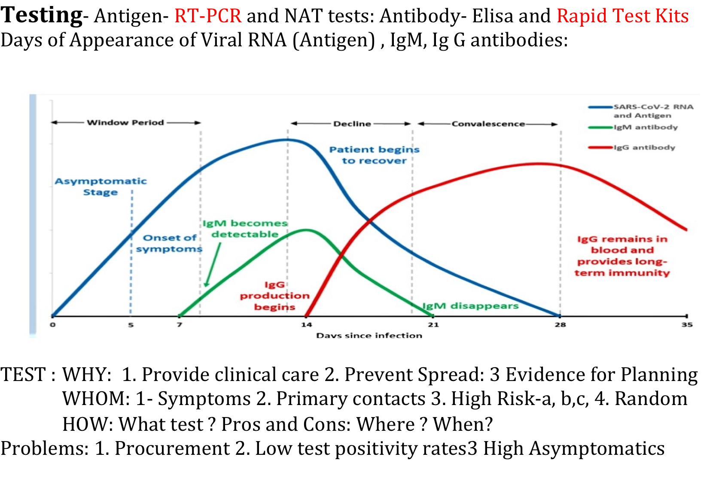
Notes:
Tests can be seen as antigen tests or antibody tests. Antigen tests are tests to detect the viral particles. Usually sample is a nasal swab. In graph above day 0 is when infection is acquired and day 5 to 7 is when symptoms develop and day 7 to 14 is when symptoms are prominent. People are most infective at this stage. Viral ( antigen ) tests are most reliable at this stage. The blue line indicates antigen levels on different days. Currently swabs for antigen tests have to be taken with great care- wearing PPE- and sent a very few labs- and then reported. Usually gaps of one to three days to get report. Symptomatic persons, clinical diagnosed as COVID have to be in isolation- not quarantine. Once confirmed they MUST be in institutional isolation.
Antibodies are of two types- Ig M starts rising on 5th to 7th days, and is present upto day 21. Before or after that it will give a false negative. Ig G rises from day 14 and is then present for months or years. After day 21 , and certainly after day 28, patient may have recovered but will continue to have antibody test positive. Which would be a false positive if one is trying to detect active disease and infective person. But quite reliable to know whether infection is present now or anytime in the past.
There are over 200 antibody tests that are now available. And we do not quite know which are Ig M and which Ig G testing and which test for both. Ideally it should test for both. Then in a patient with clinical symptoms ( 3 days after symptoms have developed or 7 to 10 days after infection) the antibody test is reliable to detect active disease. If no symptoms are there and test is positive we will need to do an antigen test to confirm active infection. If no symptoms are there and test is negative but there is a contact history we need to rule out active infection then we need to do an antigen test to rule out infection. When we validate a specific antibody test we have to be checking whether the test being validated is able to detect antibodies in the blood as determined by some other assured way ( gold standard ). Merely comparing it with antigen test is misleading, and not in good faith. Antibody tests need far less protection to perform, results are available in 15 to 20 minutes and can be done even in PHC level. So if ordered and interpreted by a trained doctor it is very useful.
WHY TEST: Testing persons with COVID 19 like symptoms- irrespective of history of contact- is the very core of disease surveillance. As long as we do not do this, we should not make any claims about the prevalence of infection. Testing is essential to provide appropriate care and prevent spread.
WHOM to test- given above- in that order of priority. All patients with COVID 19 like symptoms for more than 3 days should go for testing. Primary close contacts whether or not asymptomatic
In high risk- health workers on covid 19 duty, other health workers coming close to many patients, other service providers with likely multiple contact with infected person, immunosuppressed persons. Random sampling has little role unless samples are large enough and well structured sampling design- and even then more of a research tool than immediate epidemic management.
HOW- the currently used antigen test is RT-PCR and the currently used antibody test is the the rapid test kit. There are other tests that may become available. Ideally testing should be at home, or patient should be transferred by COVID ambulance to a designated sample collection center. This reduces chances of infection. Alternatively patient could be asked to go to such center.
Source: 2020 Mar 11. doi:10.1001/jama.2020.3786. 2. Drain PK, Garrett NJ. The arrival of a true point-of-care molecular assay-ready for global
implementation? Lancet Glob Health. 2015 Nov;3(11):e663-4.3. Juanjuan Zhao et al. Antibody responses to SARS-CoV-2 in patients of novel coronavirus
disease 2019. www.medrxiv.org. March 03, 2020 doi.org/10.1101/2020.03.02.200301894. Fatima Amanat et al. A serological assay to detect SARS-CoV-2 seroconversion in
( taken from a Kerala govt presentation- by Dr Arya Sivaprasad Clinical Microbiologist General Hospital Ernakulam)

Slide 4
Isolate & Trace
Positive case : Isolate Contact: Quarantine:
SITE @ home, @ community managed institution @ hospital
Tracing: Volunteers , Patience, Trust, Coperation:
Social media - the south korean model
Problems/Critiques in the Indian strategy:
Coercive Isolation:
Aarogya Setu and its dangers.
Circular geographical hot-spots : is it relevant
Area disinfection & Masks:
Notes:
All positive cases must be isolated in a facility. Difference between isolation and quarantine must be noted. Positive cases need observation because they can slip into severity without recognition ( home could be associated with higher mortality), because they can actively spread disease- and they are far far more infective than asymptomatic persons. Care givers need PPE
In certain circumstances home isolation can be allowed- as a matter of choice, where there is reasonable reliability of being able and willing to follow it, and because it is more humane, like in a very elderly or terminally ill who consciously make that choice.
In quarantine- however, home quarantine is a good choice though community managed hotels or hostels or some non-busy hospitals could play this role where effective home quarantine is not feasible. . The moment they test positive or develop symptoms- they may need to shift to isolation. Care givers need to take moderate to mild risk PPE- but not at high levels. Thus community management is more feasible- and more humane. More choice is possible- but observation is a must.
Tracing requires cooperation and community engagement. It cannot happen where there is no trust and where conditions of isolation and quarantine or coercive and violations of dignity.
Need to explain the problems with the government strategies listed above: Coercive isolation or quarantine, aarogya setu. Also the absurdity of the circular hot-spot. Am I more at risk if my neighbour tests COVID 19 positive. Not really. It is who all I come into contact with which is critical- though there can be overlaps. Many of the disinfection spraying shown on the media- or merely photo-ops. Have no real value.
To discuss masks and universal masks in some detail.

Slide 5
Treat:
Mild and Moderate- Observation: Isolation Facility- not at home preferably
Severe- Breathlessness: Hospitalize- maybe oxygen
Critical- Intensive Care- Ventilation:
Hospital capacity for isolation/ for critical care: ICU beds and ventilators
Problems in Indian strategy:
Difference between creating surge capacity and re-purposing hospitals: For ICU beds and for ventilators
Which hospitals to re-purpose?
What role for the private sector & The costs of care
Preventing Hospital Acquired Infection- and Ensuring Health Worker Safety
Notes:
If breathlessness develops or being sick worsens- must be treated as severe and hospitalized under effective medical care. Most will need oxygen.
Current government policy is to re-purpose busy public hospitals into COVID 19 hospitals- by displacing poor persons with other essential health care needs. Discuss each of these problems-a s where government policy is currently going wrong.
Discuss the role of private sector as it is shaping out..
Give an understanding of what is required to prevent hospital as source of spread ( kerala example) and ensure health worker safety ( the crisis in PPEs)

Slide 6
So what about lock-downs
Physical Distancing Lowers R0 : Needed at each contact site:
Site specific closures OR a closure of all sites viz. lock-down
Contact Sites: (S1 to S5)
At place of residence
At schools and colleges
At work places:
At community- (a)access to essential services, (b) recreation, (c)cultural gatherings (d) immediate neighborhood
In public transport:
Take decisions on each contact site based on : No of likely contacts in Site * probability of transmission in each site *increase in contacts in other sites if shutdown in S₍₁₋₅₎ * likely extent of compliance in S₍₁₋₅₎
Meaning of community transmission: Lockdowns are always about responding to community transmission, never about preventing it.
Difference between containment and mitigation :
Notes:
Meaning of community transmission: Where the positive patient from whom the disease was acquired is not known. If cases occur in only those contacts who are under observation, the disease is under control. But if they occur outside this pool, then it should be seen as community transmission- even if we can subsequently figure out a contact.
Lockdowns are always about responding to community transmission, never about preventing it. Question has been whether to lock-down when community transmission is low, or when there are large clusters affected or when it is there in every part of the state or nation.
The difference between containment and mitigation is in immediate objective < Containment objective is to bring R0 below 1. In mitigation we are willing to accept a R0 above 1. But the main strategy is the same. Ove.
Social mixing occurs at many contact sites as listed above. The restriction of activity at each site causes one incremental decrease in R0. For example the closure of schools and colleges for example would lower R0 by 0.6 ( in the UK). Of public transport by (say) 0.5. Of essential health services by (say) 0.6. Of construction sites by (say) 0.3. . There is also a likely compliance factor. Based on this information we choose which activity to restrict and which not to restrict. In most parts of the world essential health services would not be restricted- but if we can ( politically ) get away with shutting it down, LMIC nations with highly privatized healthcare may think nothing of doing so. This is the meeting point of public health with ideology and politics. In India we lack data and we lack the will to get the data.
Our understanding should be that to restrict activities minimally and never all at the same time and without giving due notice and time for preparation. The more we are confident of “ Identify, Test, Isolate, Treat and Trace- “ the less we will need to go for restrictions. Choosing restriction over ITITT as strategy is often a lack of capacity , laziness and the preference for coercive measures in authoritarian states. This goes along with under-reporting illness and deaths.
The basis of restriction should be data- on the spread of disease ( see slide 1) and social mixing patterns.

Slide 7
Till we get to the vaccines and the drugs…
…... And the next pandemic
Thank You

